Slide 1
An effective equilibrium reaction model for the submerged plasma fuming process using ChemApp
Zhongfu Cheng, Bart Blanpain, Muxing Guo

Slide 2
Research background
Model development
Modeling case
Results and discussion
Conclusion
2

Slide 3
Backgrounds
Plasma fuming:
  Cooler
6
Technical advantages:
Recover considerable amounts of valuable metals;
Allow valorization potential of slags;
Produce clean slag for novel inorganic polymer.
Existing works:
crucible-scale experiments
industrial measurements
mathematical models
thermodynamic analysis
effective equilibrium reaction zone
computational fluid dynamics simulation
……
  Off gas
5
Premixed feed
4
Develop a kinetics model for plasma fuming process to fully understand the influence of parameters on the kinetics of metal fuming, allowing optimization of process variables
Secondary air
Post
combustion
Compressed air+NG
3
Compressed air
Slag bath
Slag bath
1
2
Plasma torch
Tuyere
Slag Matte
3

Slide 4
Reaction zones of plasma fuming process
Cooling
Upper plasma generator
R0 – Start slag melt
R1 – Plasma generation
R2 – LPG gas combustion
R3 – Feed raw material melt
R4 – Coal-slag reaction
R5 – Slag mixing
R6 – Gas-slag reaction
R7 – Reacted slag homogenization
R8 – Off gas removal from slag bath
R9 – Electrical heating of slag
R10 – Heating loss
Feeding raw materials
R8
R3
R0
R10
R7
R5
LPG
R4
Air
R9
R6
R1
R2
lower plasma generator
4

Slide 5
Model structure for plasma fuming process
Start slag
Elements input
Power input
R3
R1
Feeding materials
Coal stream
Air stream
Natural gas
R0
R4
Equilibrated slag
Premixed slag
R2
R5
Combusted gas
R9
Mixed slag
Reaction kinetics
R10
Unreacted slag
Reacted slag
Reacted gas
Unreacted gas
R6
Slag-gas equilibrium
R7
R8
Homogenized slag
Off gas
5

Slide 6

Kinetics model--Effective equilibrium reaction zone (EERZ) model
Continuous feeding
Injection gas
Bulk gas
Bulk slag
Reaction level;
Mass transfer coefficient solving the amount of reactive slag:
Fitting with experimental data;
Short circuiting gas
Reactive gas
Reactive slag
Unreacted slag
$$R_{t}=k_{i}A\left({\left(C_{bulk, i}\right)}_{t}−{\left(C_{interface, i}\right)}_{t}\right)∆t$$
Equilibrium
Fitting
Off gas
Equilibrated slag
The influences of process variables are incorporated in the mass transfer coefficient
6
Notes:
This figure shows the details of my kinetics model. It is developed based on the EERZ model. Specifically, for a given time step, a certain amount of slag and gas will reach equilibrium, and the equilibrated slag will return to the bulk slag, and the gas products will return to the bulk gas, forming the off gas, and finally flow out of the reactor. The reaction level is determined by the amount of reactive slags. The reactive slag was calculated by the first order mass transfer equation, so the key parameter is the mass transfer coefficient. It was solved by fitting with experimental data. Obviously, the influence of process variables are incorporated in this coefficient.

Slide 7
Reaction interface
Slag volume fraction
Short circuiting gas
Numerical simulation of fuming furnace
(Gas velocity 50 m/s, t=10s)
Reaction interface area A is a function of foaming slag height, evaluated based on the numerical results.
7

Slide 8
ChemApp-based fuming model
Equilibrium calculation;
Effective equilibrium reaction zone (EERZ) model for kinetics;
Time step concept.
a
Three key steps
b
Reaction kinetics model
Model structure
Reasonable kinetics model
Thermodynamic calculation
c
8

Slide 9
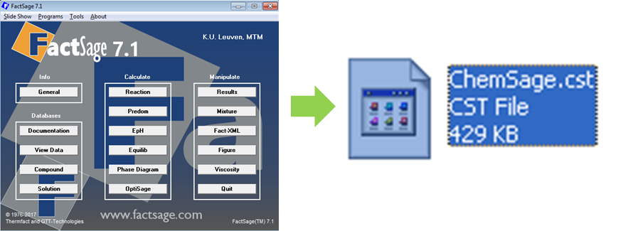
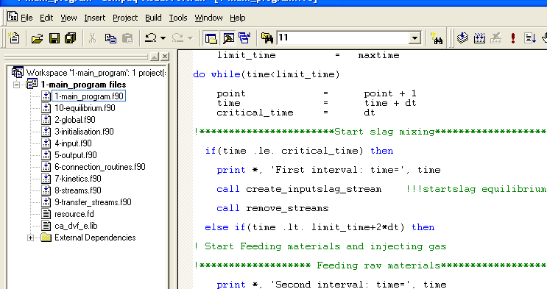
Model implement
ChemApp
10. Calculate equilibriums
Incorporate all the reaction zones
Define global variables
Initialize chemApp and calculation conditions
Read input data
Write results
Connect transfer streams
Call the kinetics model
Definite all the reaction streams
Store reacted streams
Highly modular
9
Notes:
This model was implemented by ChemApp as shown this figure. At the same time, the database of Factsage was imported into ChemApp to calculate the equilibriums. My ChemApp code model includes 10 parts of subroutines. It allows to use separate input and output files.

Slide 10
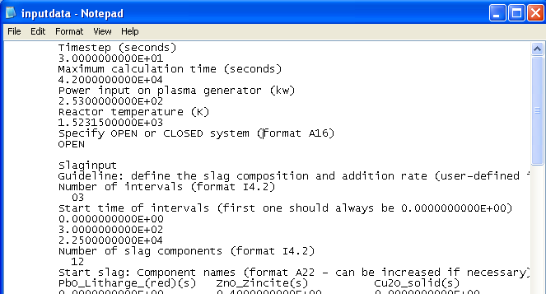
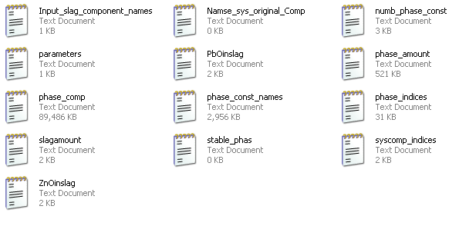
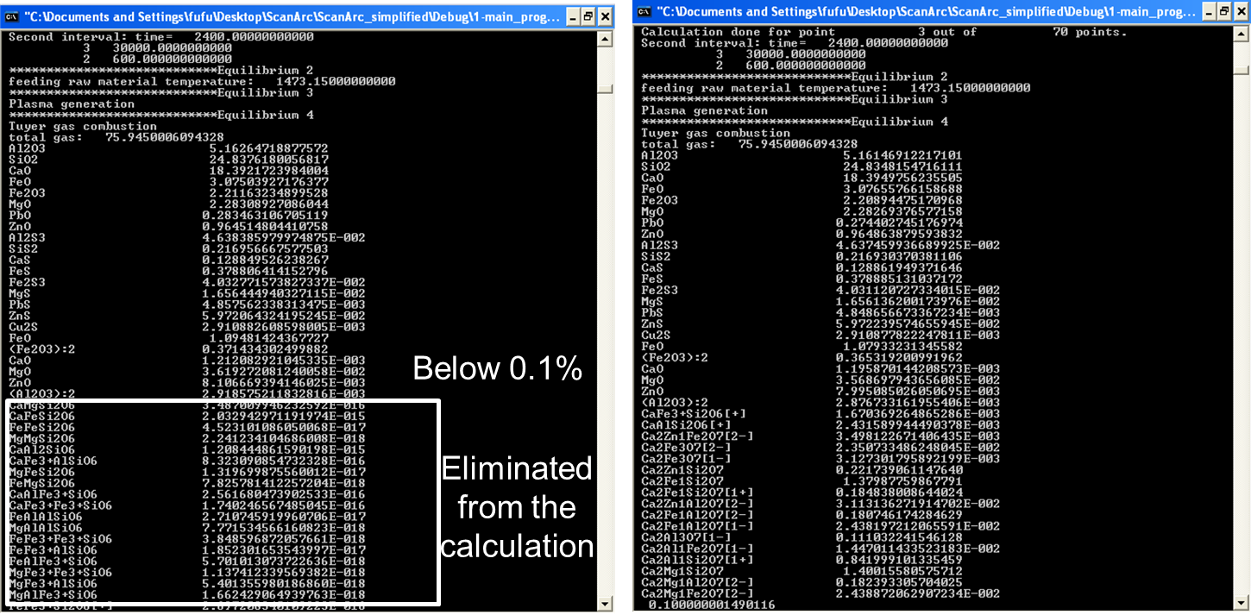
Model characteristics
Great flexibility to design and implement FactSage calculation;
Customized reaction kinetics;
3) Flexible input
4) Powerful output
5) Controllable computational efficiency
10
Notes:
I also give a short instruction of my model characteristics.1. The current ChemApp-based model provides great flexibility to design and implement FactSage calculation. 2. It allows to customize reaction kinetics; 3. It provides flexible input, any process parameters you want to consider can be input the calculation, such as temperature, gas flow rate, slag compositions, gas compositions. It even allows to use elements as input; 4. It has powerful output. Any variables you are interested can be set as an output. 5. In addition, in order to improve the computation efficiency, I also optimize the calculation methods. So the calculation efficiency becomes controllable. It allows to run in your personal computer.

Slide 11
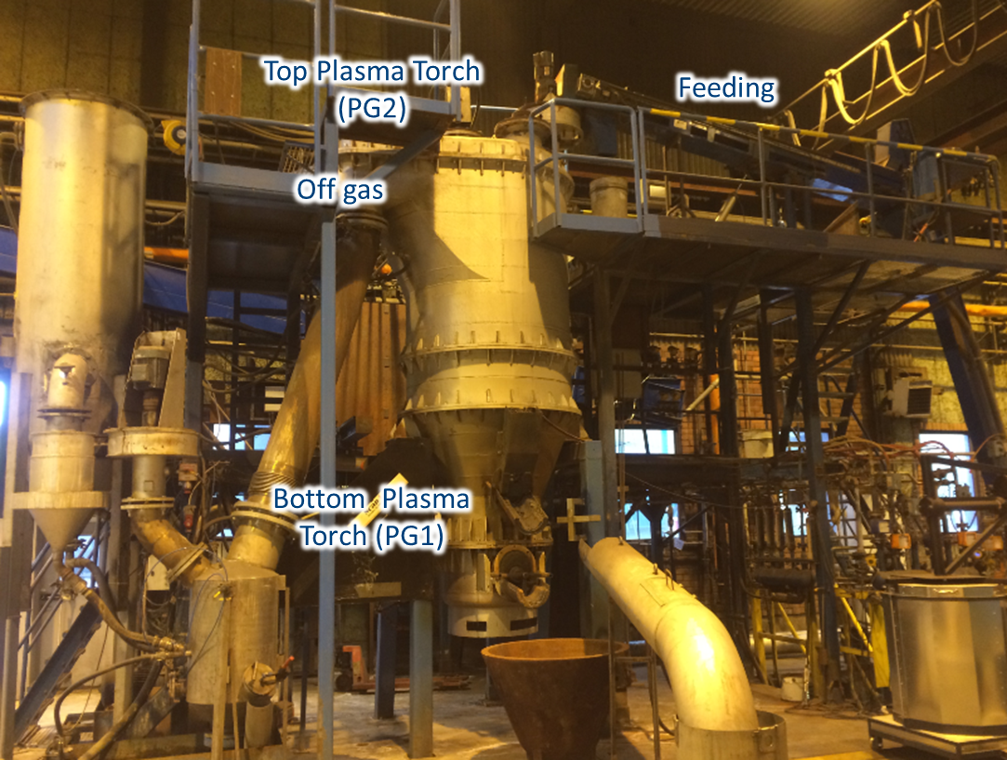
Modelling case
11

Slide 12
Modelling case
I
II
III
Reducing
Start slag melting
Raw material feeding
Reducing
Coal amount=s1
Coal amount=s2
Raw material feeding
Start slag melting
r1>r2>r3>r4
s1<s2
Air/LPG=r1
Air/LPG=r2
Air/LPG=r3
Air/LPG=4
12
Notes:
The ChemApp-based model was applied to simulate the plasma fuming process. In the current modelling case, the fuming was divided into three stages, namely, start slag melting, raw material feeding and reducing. Every stage has its individual operation parameters. The modelling results are shown on the next page.

Slide 13
Results and discussion
Feeding
Air/LPG=r2
Reducing
Air/LPG=r4
Start slag
Species | Terminal amount (wt%)
 | Experiment | Prediction
ZnO | 0.5788 | 0.3930
PbO | 0.0273 | 0.0257
Comparison between the simulation results and the experimental data for the concentration profiles of ZnO and PbO
13

Slide 14
Results and discussion
Start
slag
Feeding
Air/LPG=r2
Reducing
Air/LPG=r4
Comparison between the simulation results and the experimental data for the concentration profiles of slag components
14
Notes:
Obviously, the predictions show good agreement with the experimental data. The residual concentrations of zinc oxide and lead oxide in different stages are well predicted. The target values of residual zinc and lead are also consistent with the measurements.

Slide 15
Conclusions
An effective equilibrium reaction zone model has been developed to describe the plasma fuming process.
ChemApp was applied in this model to design the model and implement the simulation.
This model can be further extended to investigate the influence of process parameters on the fuming efficiency.
PbO in the slag below 300 ppm.
15

Slide 16
Thank You
16

